Slide 1

DEPARTMENT OF ARTIFICIAL INTELLIGENCE AND MACHINE LEARNING
“ALZHEIMER’S DISEASE DIAGNOSIS USING DEEP LEARNING APPROACH”
Presented by Group 5: Under the guidance of: Dr. CHANDRASEKHAR BN
1BY20AI009 : Aravind Suresh
1BY20AI024 : M S Kaushik
1BY20AI044 : Sandeep Arockia Samraj
1BY20AI402 : Raj Powell

Slide 2
Index
Contents Slide Number
Base paper screenshots 03
Motivation 04
Introduction 06
Literature survey 07
Problem statement 08
Objectives of project 09
Methodology 10-13
Timeline 14
References 15-16

Slide 3
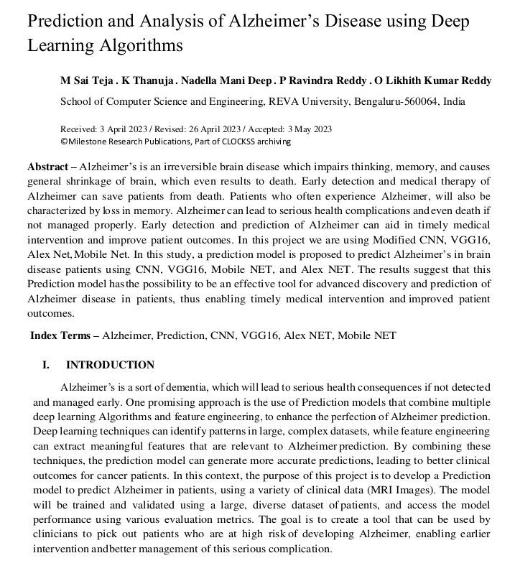
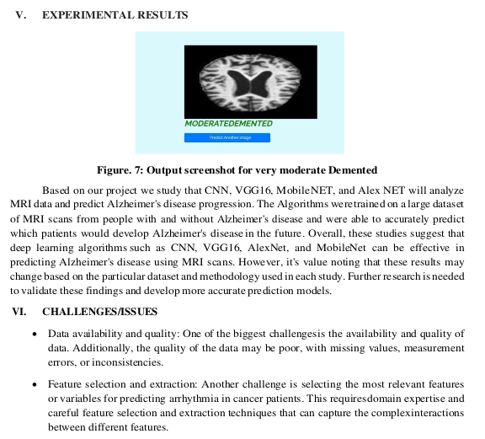
Snap shots of base base paper

Slide 4
Motivation
Our Alzheimer's disease detection project is driven by the profound societal impact it offers. By leveraging deep learning techniques, we aim to revolutionize early diagnosis, potentially improving the lives of millions affected by this debilitating condition. Our work not only advances scientific understanding but also provides a unique opportunity for personal growth, enabling you to develop expertise in machine learning and data analysis. This project not only serves as a stepping stone for career opportunities in healthcare and AI but also as a chance to make a real difference in the world.

Slide 5
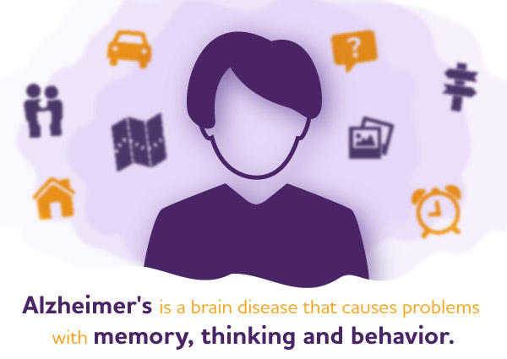

Slide 6
Introduction
Alzheimer's disease, a form of dementia, poses significant health risks when not detected and managed early. To address this challenge, we are developing a prediction model that combines multiple deep learning algorithms and feature engineering techniques, leveraging MRI images and cognitive testing data to enhance the accuracy of Alzheimer's prediction. Deep learning excels at identifying patterns in complex datasets, while feature engineering extracts meaningful features crucial for predicting Alzheimer's.
In parallel, we are also working on a cognitive testing project aimed at assessing cognitive decline. The overarching goal is to create comprehensive diagnostic tools. By training and validating our models with diverse patient datasets, we aim to empower clinicians with the ability to identify high-risk patients at an early stage, allowing for timely intervention and improved management of both Alzheimer's disease and cognitive decline, ultimately resulting in better clinical outcomes.

Slide 7
Literature Survey

Slide 8
Problem Statement
The project addresses the need for accurate and early prediction of Alzheimer's disease and cognitive decline, utilizing deep learning algorithms and cognitive testing data to enhance diagnostic precision and facilitate timely interventions for improved patient care.

Slide 9
Objectives of project
Develop Robust Prediction Models: Create advanced deep learning-based prediction models that incorporate MRI images and cognitive testing data to accurately identify patients at risk of developing Alzheimer's disease and cognitive decline.
Enable Early Intervention: Provide clinicians with a practical tool for early risk assessment, allowing for timely interventions and improved management strategies, ultimately leading to better clinical outcomes for Alzheimer's disease and cognitive decline.
User-Friendly Interface: Create an intuitive and user-friendly web application interface that ensures a positive user experience, catering to the needs of both novice and experienced users.

Slide 10
Methodology
Convolutional Neural Network (CNN) for Alzheimer's Detection:
Utilize CNN, a deep learning algorithm suited for image and video analysis.
CNN autonomously extracts features from raw pixel data, eliminating manual feature extraction.
Multiple layers with specific functions in feature extraction, including convolutional and pooling layers.
Fully connected layers for classification.
Employ ReLU activation functions for non-linearity.
Backpropagation trains the network.
Successful application in medical image analysis, among other tasks.

Slide 11
VGG16 Model for Cognitive Testing and Alzheimer's Detection:
Integrate VGG16, a deep CNN architecture with 16 layers.
Accepts 224x224x3 images in the input layer.
Convolutional layers grouped into five sections for feature extraction.
Fully connected layers perform classification.
ReLU activation functions introduce non-linearity.
SoftMax layer standardizes network outcomes into class probabilities.
Suitable for image recognition but computationally demanding.

Slide 12
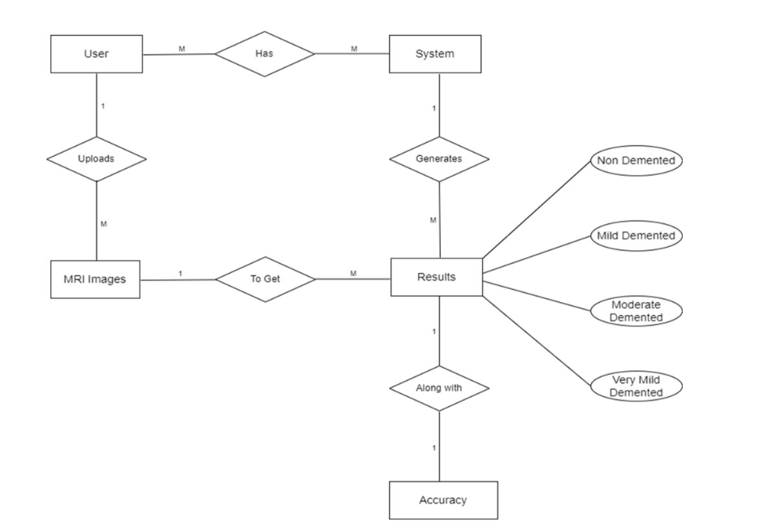
Figure. 1: E-R Diagram for Alzheimer’s Disease Prediction

Slide 13
Integration of Cognitive Testing:
In our project, we extend the deep learning framework to incorporate cognitive testing features. This involves the inclusion of additional data sources such as cognitive test scores, behavioral metrics, or neuropsychological assessments.
The integration aims to enhance diagnostic precision and provide a holistic understanding of patients' cognitive health. This combined approach enables a more comprehensive evaluation of cognitive decline and Alzheimer's disease, yielding potential breakthroughs in early detection and intervention strategies.
These methodologies combine deep learning techniques with cognitive testing to enhance Alzheimer's detection, making it a comprehensive approach for early diagnosis and intervention.

Slide 14
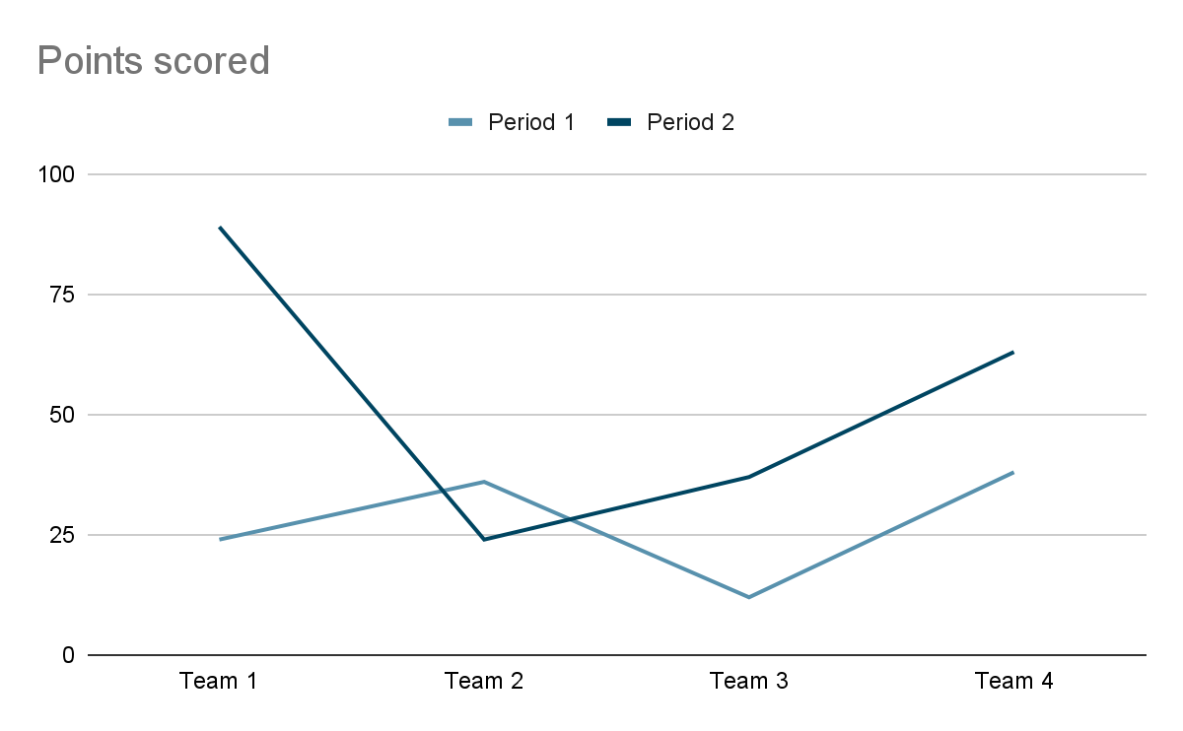
Timeline

Slide 15
References
Oh, K., Chung, YC., Kim, K.W. et al. Classification and Visualization of Alzheimer’s Disease using Volumetric Convolutional Neural Network and Transfer Learning. Sci Rep 9, 18150 (2019). https://doi.org/10.1038/s41598-019-54548-6
Taeho, J., Kwangsik, N., & Saykin, A. J. (2019). Deep Learning in Alzheimer's Disease: Diagnostic Classification and Prognostic Prediction Using Neuroimaging Data. Frontiers in Aging Neuroscience, 11. https://www.frontiersin.org/articles/10.3389/fnagi.2019.00220
Kavitha C., Mani Vinodhini, Srividhya S. R., Khalaf Osamah Ibrahim, Tavera Romero Carlos Andrés. "Early-Stage Alzheimer's Disease Prediction Using Machine Learning Models." Frontiers in Public Health, 10 (2022), https://www.frontiersin.org/articles/10.3389/fpubh.2022.853294, DOI: 10.3389/fpubh.2022.853294, ISSN: 2296-2565.
M Sai Teja, K Thanuja, Nadella Mani Deep, P Ravindra Reddy, & O Likhith Kumar Reddy. (2023). Prediction and Analysis of Alzheimer’s Disease using Deep Learning Algorithms. International Journal of Computational Learning & Intelligence, 2(2), 48–57. https://doi.org/10.5281/zenodo.7920940

Slide 16
Shamna, K. Ayisha and Pm Shameena. “CNN Based Landmark Detection and Alzheimer’s Diagnosis Using Landmark Feature.” (2018).

